Slide 1
Flight Delay Analysis
Understanding What Keeps Flights Waiting

Slide 2

Overview
This project aims to analyse flight delay data in conjunction with historical weather data and other relevant factors to understand the multi-faceted nature of flight delays. By conducting a comprehensive analysis, we hope to identify key factors that contribute to delays, including weather conditions, airline-specific patterns and the impact of routes (country of origin and destination). Through this approach, we hope to provide a nuanced understanding of the various factors influencing flight delays and develop insights for airlines and passengers to improve travel planning and minimise disruptions.

Slide 3
Data source and key questions
Flight delay data sourced from: https://www.kaggle.com/datasets/deepak007chaubey/flight-on-time-dataset
1
Which airports have the highest rate of flight delays? What factors contribute most to delays at these airports?
3
How do weather conditions at the airport (precipitation, wind, visibility etc.) impact flight delay rates?
2
How do departure and arrival delays vary by time frame? Are there certain days of the week that are associated with more delays?
4
Are there certain airlines that exhibit better (or worse) punctuality? What are some factors that may be contributing to this?

Slide 4
Project objective
Present our findings to stakeholders in hopes of improving delays and improving overall flight performance.

Slide 5
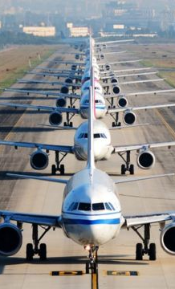

Airport Analysis
“Let's talk about why flights get delayed. A big part of the story is about airports. Just like how a busy train station can cause train delays, busy airports can cause flight delays. In this slide, we'll look at which airports have the most delays and try to figure out why. This will help us think about how to make things better.”
Highlights
Top Delayed Airports
Peak Delay Times

Slide 6
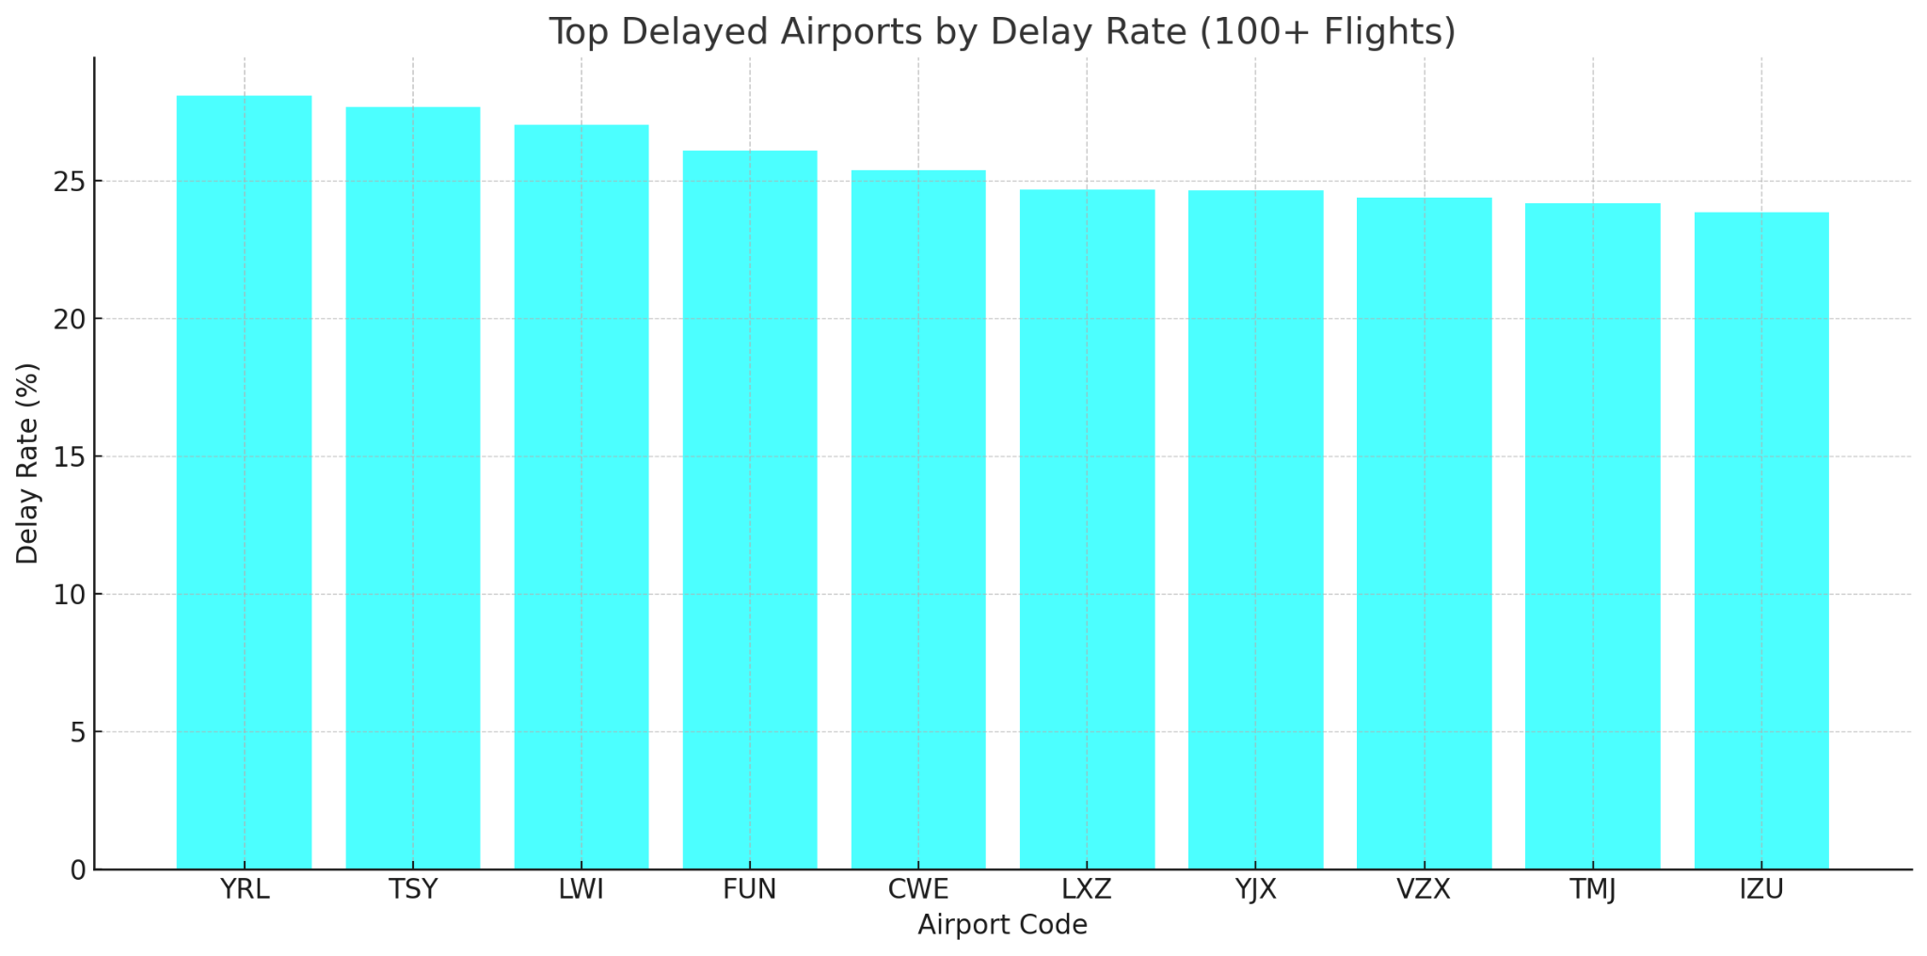
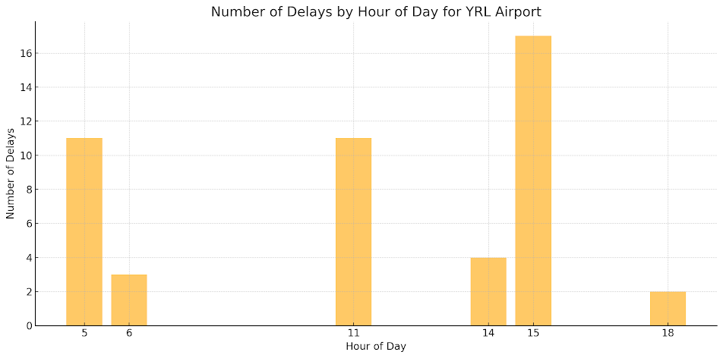
Comparing Delay Rates at Busy Airports
This chart shows which busy airports (with 100 flights or more) have the most delays. Red Lake Airport (YRL) tops the list with 28.07% delays. You can easily compare how different airports do. It's clear that each airport's situation and other factors play a big role in how often flights are delayed
Red Lake Airport: Morning and Afternoon Delay Patterns
Red Lake Airport has two main times when flights get delayed: early morning (4-6 AM) and late afternoon (3-4 PM). The morning delays might be from issues the night before or the weather. The afternoon delays? Could be due to the busy rush. It's an interesting pattern to look into."

Slide 7
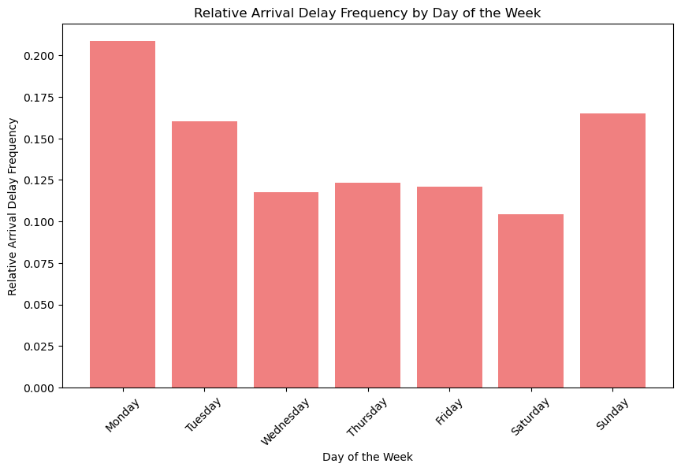
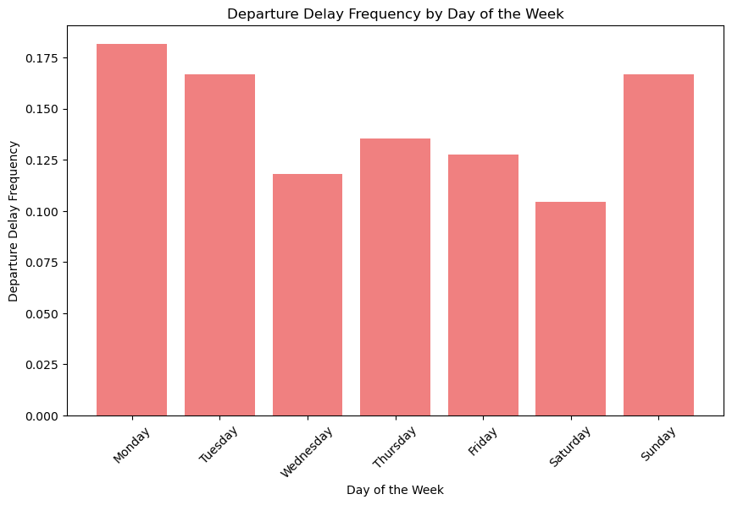
Day of the week analysis: Impact on delays

Slide 8
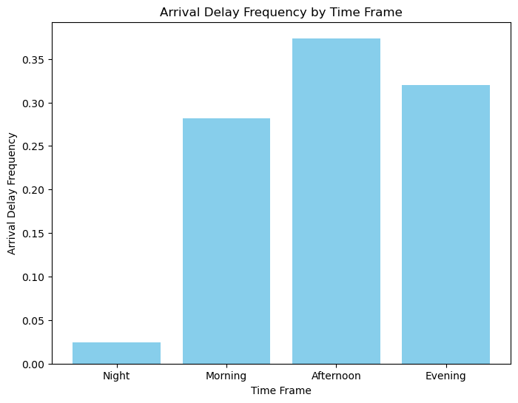
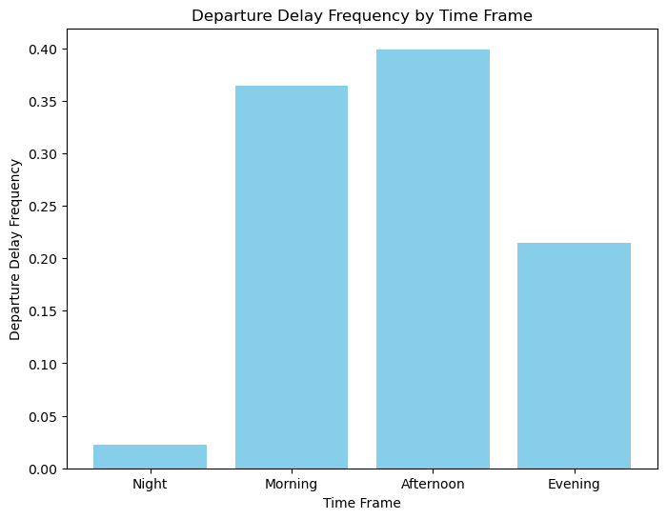
Time of day analysis:
Impact on delays

Slide 9
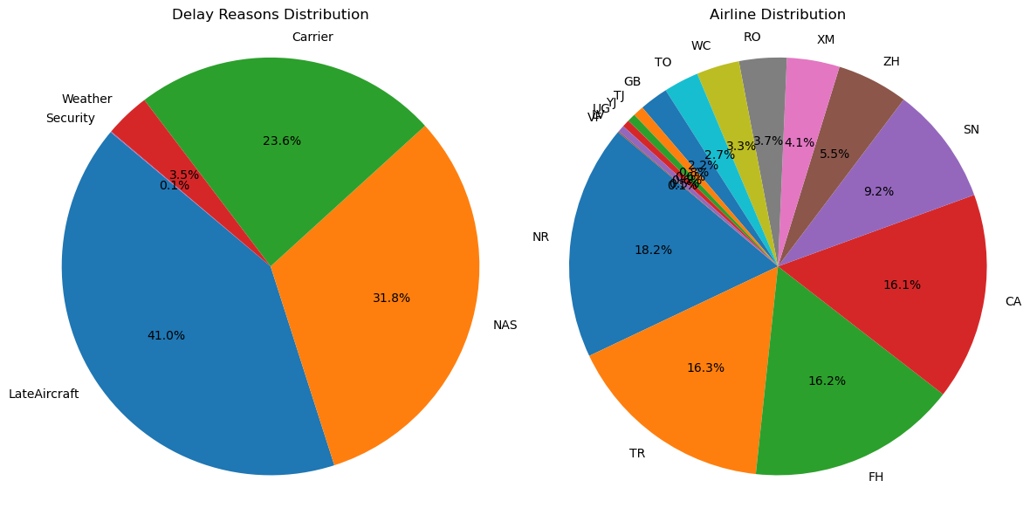
Airline Analysis
Delay type and Airline Distribution

Slide 10
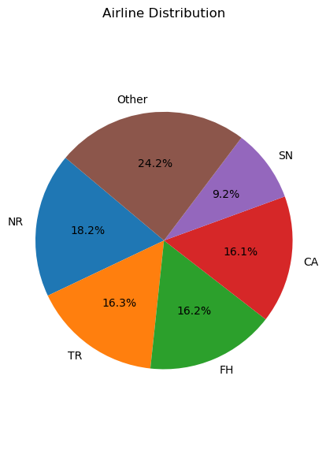
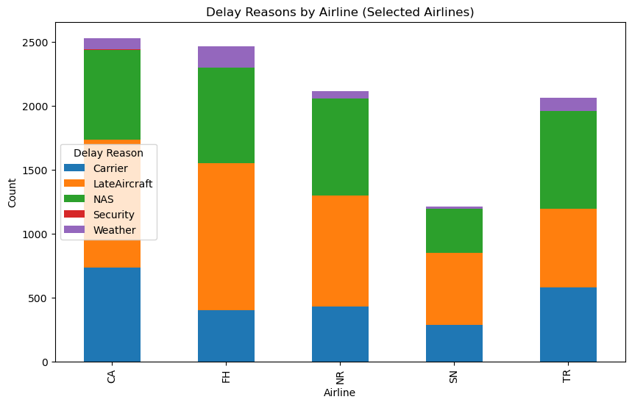
Airline Analysis
Delay Reason and Airline Distribution

Slide 11
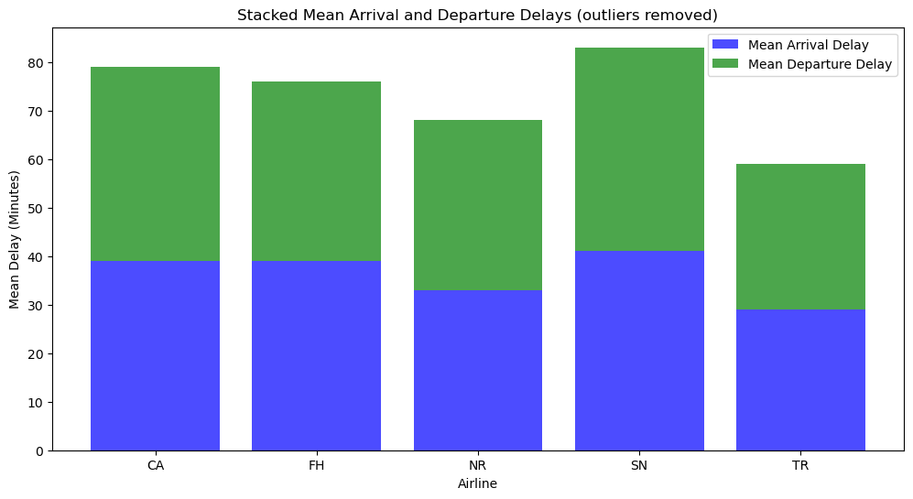
Airline Analysis
Total average delayed time per airline (no outliers)

Slide 12
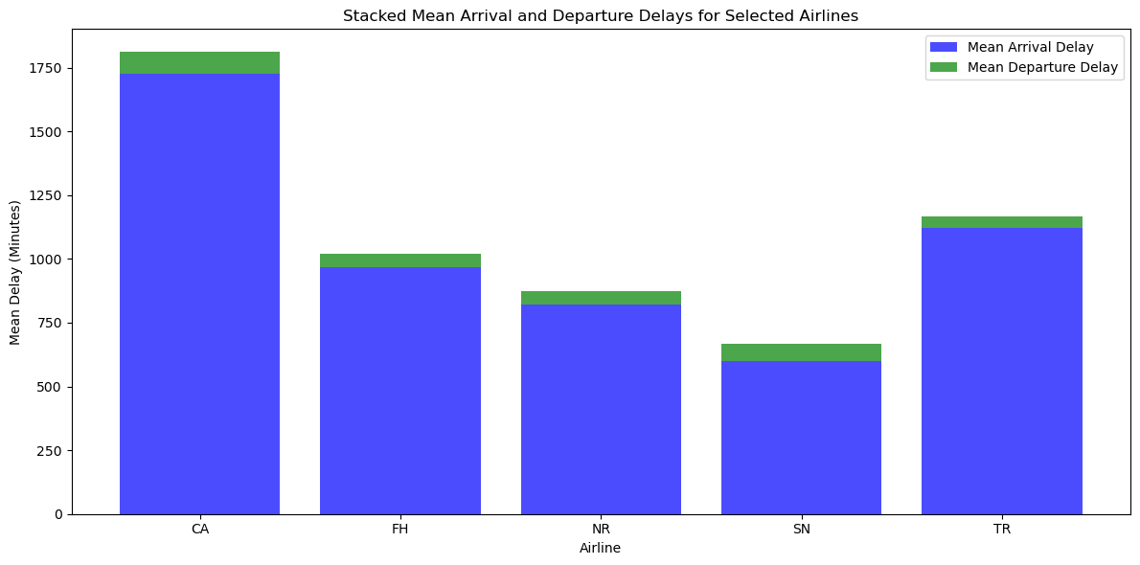
Airline Analysis
Total average delayed time per airline
Conclusion:
- In conclusion we can mention CA to be a specific airline to look into being that it has the most airline delay per reason and the worst mean average time per delay in minutes.
- The tracking system with delay in minutes also needs to be looked at for having too many outliers that affect the data taking it to a completely different result.

Slide 13

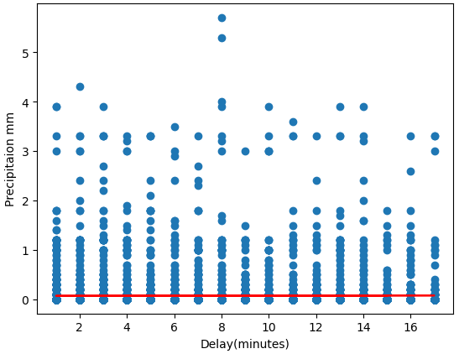
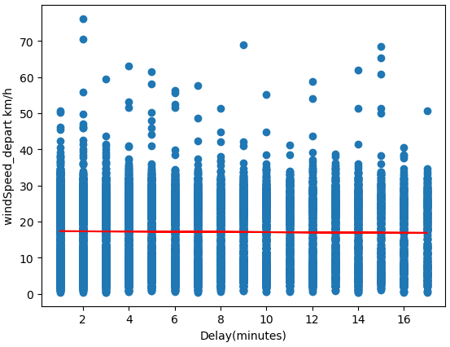
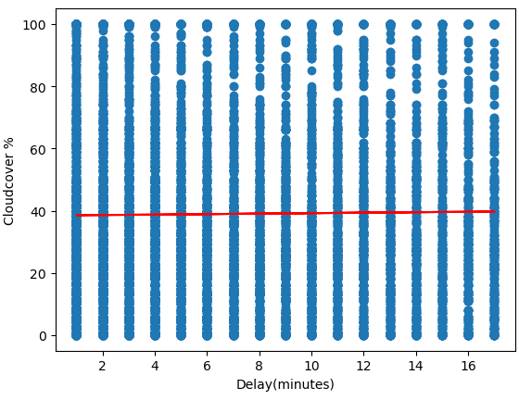
Since the initial data only had the airport IATA code, we had to web scrape the city names from a website to include in the dataframe
Flight delay data sourced from: https://www.kaggle.com/datasets/deepak007chaubey/flight-on-time-dataset
Data collected from historical weather API for precipitation, cloud cover and wind speed shows no correlation with flight delays

Slide 14
Conclusion
In conclusion, we’d like to reiterate that our findings were the result of an exploratory analysis and further research is recommended.
We believe we’ve laid the foundation for more focused investigation and would like point out some key areas to explore further.
More refined data collection
Operational adjustments
Collaboration among airlines and airport
Continuous monitoring

Slide 15
Thank you.
Team Members
Anthony Noreska Eduardo Castro
Hanns Peter Princivil
Joshua Modina

